Slide 1


REVIEW - 3
ANOMALY DETECTION IN IMAGES USING TRANSFORMERS-BASED GANS
Presented By Nayan Khemka (20BCE1884) Guide: Dr. Premalatha M.
1

Slide 2
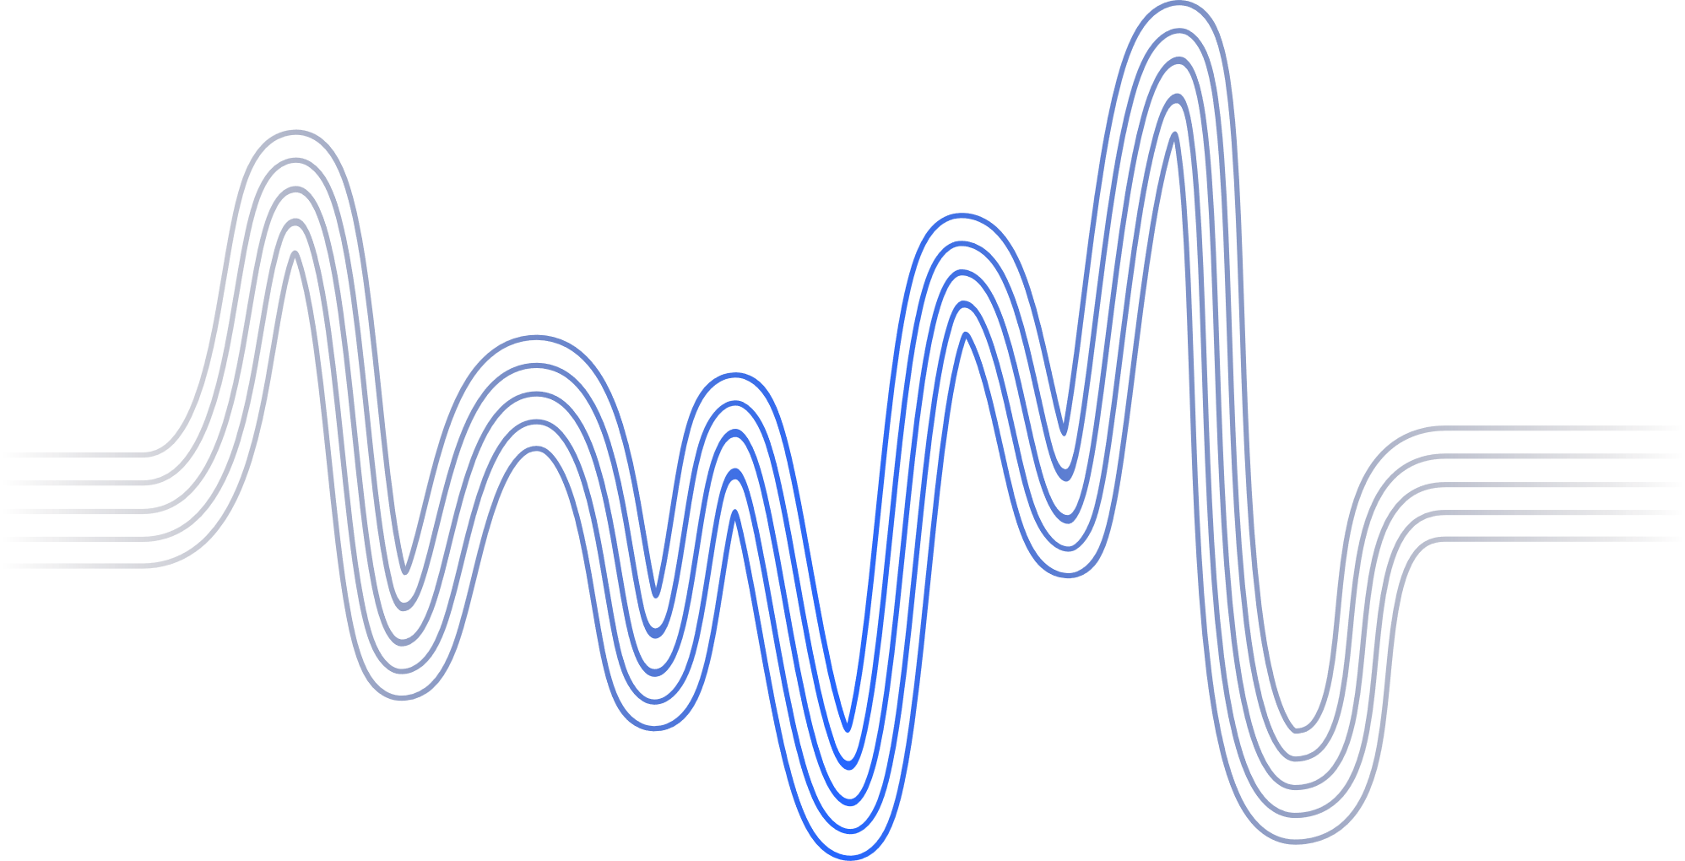
Introduction
Problem Statement
Research Objectives
Proposed System
Implementation and Results
Conclusion and Future Work
Research Paper Status
Guide Approval
References
AGENDA
2

Slide 3
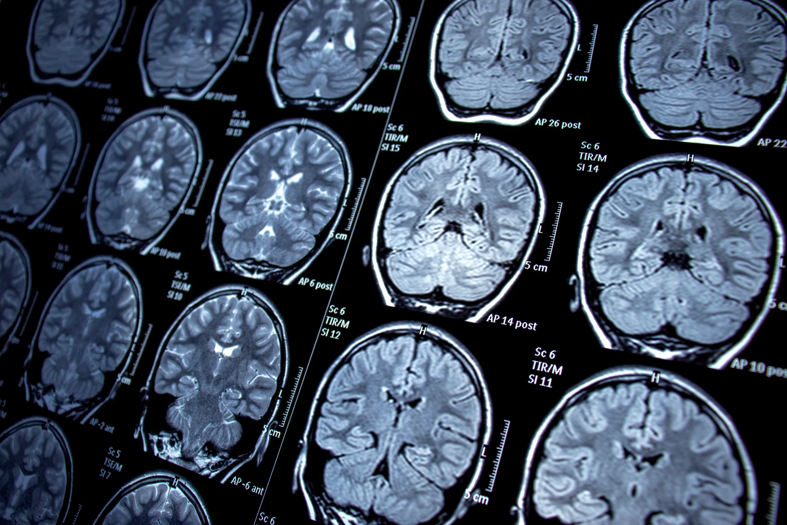

INTRODUCTION
This research proposes a novel approach to anomaly detection in images using a combination of transformers and Generative Adversarial Networks (GANs)
Back to Agenda
3

Slide 4

INTRODUCTION
In recent years, anomaly detection in image data has gained significant attention due to its wide-range applications in various domains such as manufacturing, medical imaging and surveillance. Conventional approaches hardly grasp the complexity of intricate image dataset since they rely on manually created features or statistical models. Using architectures is hence essential for obtaining superior performance in the field of anomaly detection in images a variety of. In this study, two different approaches both focused on TransGAN. Unlike traditional GANs, which primarily rely on convolutional layers, TransGAN utilizes TransformerEncoder layers to capture spatial dependencies. This enhances the quality of images that are produced and enable usage across several applications. We use iterative latent space mapping method for anomaly detection for MVTEC-AD data set. For unbalanced dataset CIFAR-10 dataset, we use ResNet50 to extract features from real image to map it to the noise input of the generator. We also make use of two discriminators one for normal data and the other for anomalous data to address the imbalance in data.
Back to Agenda
4

Slide 5
Back to Agenda
PROBLEM STATEMENT
This project is aimed at making use of advancements and approaches for anomaly detection using TransGAN architecture.
By leveraging advanced methods while addressing current challenges, goal of this project is to enhance effectiveness and applicability of the anomaly detection system in real-world use-cases.
Through experimentation of different approaches, this project demonstrates the capability of TransGAN architecture for anomaly detection across different image datasets.
Ultimately, this project aims to contribute to the increasing advancements in anomaly detection applications and provide practical solutions for real-world anomaly detection.
5

Slide 6
RESEARCH OBJECTIVES
Back to Agenda
Train TransGAN for MVTecAD and CIFAR-10 datasets and assess its performance across anomaly types and severities.
Explore the latent space representation of the Generator to detect anomalies.
Integrating ResNet50 with the TransGAN and making use of two discriminators for addressing the imbalanced dataset.
Conduct extensive experimentation and evaluation to assess the effectiveness and robustness of both the approaches used in the project.
Integrating and adapting anomaly detection techniques to new domains and application areas, each with its unique challenges and requirements.
6

Slide 7
Back to Agenda
Research Objectives
Key Discoveries:
GANs & Transformers Exploration:
Potential in anomaly detection but require more exploration.
Transformers enhance accuracy in image classification.
Combined GANs and transformers show promise but need further study.
Gaps Identified:
Lack of extensive exploration into combined GANs and transformers' potential.
Limited comparative studies to determine optimal anomaly detection approaches.
Need for practical implementations for real-world use.
7

Slide 8
Back to Agenda
PROPOSED
SYSTEM
8

Slide 9
Back to Agenda
Introduction
Objective: The primary aim of this project is to develop anomaly detection system for image datasets that exhibits robustness, accuracy, and sensitivity in identifying various anomalies.
Importance: TransGAN's departure from convolutions offers a fresh perspective in image generation, ensuring both computational efficiency and enhanced stability. In this project, we employ TransGAN for anomaly detection, showcasing its versatility beyond traditional image generation tasks.
Approach:
Our project entails training TransGAN on CIFAR-10 and MVTecAD datasets, utilizing techniques like data augmentation and relative position encoding.
For anomaly detection on MVTecAD, we implement the AnoGAN approach, leveraging the latent space representation to identify anomalies.
Additionally, we tackle the imbalanced CIFAR-10 dataset by adopting an architecture inspired by existing literature, employing multiple discriminators and diverse loss functions to enhance detection accuracy
9

Slide 10
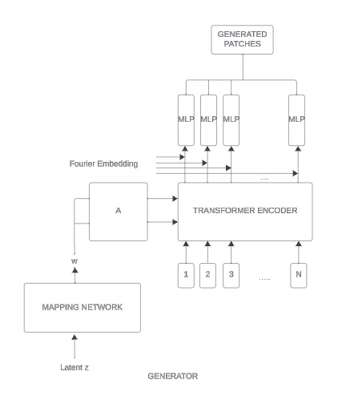
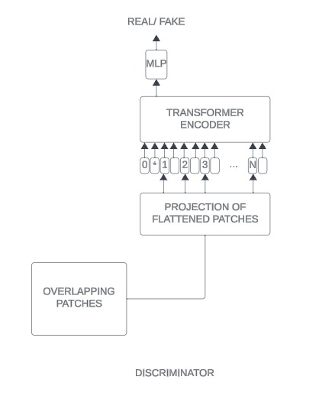
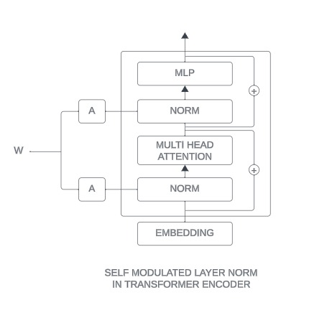
Proposed System Design
10

Slide 11
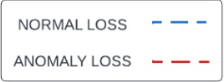
Proposed System Design
Normal Discriminator (ViT)
1 | 1 | 1 | 1
1 | 1 | 1 | 1
1 | 1 | 1 | 1
1 | 1 | 1 | 1
L1 Loss
Normal Adversarial Loss
Patch Loss
Latent vector loss
One matrix (real)
Normal image
Normal reconstruction
Transformer
Encoder
Z’
Z
ResNet50
Feature
Extractor
Transformer
Encoder
Mapping Module
GeneratorViT
Anomaly image
Anomaly reconstruction
ABC Loss
Anomaly Discriminator (ViT)
Anomaly Adversarial Loss
0 | 0 | 0 | 0
0 | 0 | 0 | 0
0 | 0 | 0 | 0
0 | 0 | 0 | 0
Zero matrix (fake)
11

Slide 12
Back to Aenda
Modules
TransGAN Module:
Utilizes transformer-based Generative Adversarial Network (GAN) architecture without convolutions.
Enhances stability and memory efficiency in image generation tasks.
Latent Space Exploration for Anomaly Detection (MVTec AD Dataset):
Utilizes the latent space representation of TransGAN for anomaly detection.
Offers a novel approach leveraging model's learned features for anomaly identification.
Anomaly Detection Module for CIFAR-10 Dataset:
Implements two discriminator-based anomaly detection approaches for imbalanced CIFAR-10 dataset.
Addresses dataset imbalances and explores diverse loss functions for improved anomaly detection accuracy.
12

Slide 13
Back to Aenda
TransGAN
Generator Design:
Comprises multiple stages with transformer blocks instead of CNN-based upscaling.
Transforms random noise input through MLP layers, generating feature maps with positional embeddings.
Discriminator Architecture:
Takes image patches as input, converting them into 1D token embeddings.
Embeds positional information before passing through transformer encoders.
Classification head predicts real/fake labels.
13

Slide 14
Back to Aenda
TransGAN
Transformer Encoder:
Central component with multi-head self-attention and MLP layers.
Enables token relation calculation within the model.
This architecture distinguishes TransGAN with its transformer-based approach, replacing traditional convolutions in both generator and discriminator modules, resulting in improved stability and performance.
14

Slide 15
Back to Aenda
Anomaly Detection in MVTec-AD
1. Data Preparation:
Each class of the MVTecAD dataset is provided with separate folders for training, testing, and ground-truth labels. This comprehensive dataset organization facilitates effective model training and evaluation.
2. Training Process:
The training process commences with the TransGAN model, focusing initially on images devoid of defects across all classes. Random noise inputs are fed into the generator, which produces synthetic images.
Concurrently, the discriminator undergoes training using a combination of real images from the dataset and the fake images generated by the generator. This training scheme leverages reconstruction and adversarial losses to optimize the performance of the GAN.
15

Slide 16
Back to Aenda
Anomaly Detection in MVTec-AD
3. Latent Space Exploration:
Following training, the latent space is explored to establish a correspondence between input images and their representations in the model's latent space. This involves selecting a random point in the latent space and employing gradient descent to navigate through the space towards the target image representation.
The loss function utilized in this process quantifies the disparity between the original input image and its generated counterpart, employing L1 loss to ensure accuracy in representation matching.
4. Feature Space Comparison:
To further refine anomaly detection capabilities, the representations of real and fake images are compared within the feature space of the discriminator. By analyzing the perceptual differences captured by the discriminator's intermediate layers, the model gains insights into distinguishing between authentic and synthetic images.
16

Slide 17
Back to Aenda
Anomaly Detection in MVTec-AD
5. Anomaly Detection:
Anomaly detection is executed by balancing reconstruction and discriminator losses to compute an overall loss metric. This metric serves as a threshold, derived from the losses observed during model training on authentic images. Test images surpassing this threshold are labeled as anomalies, while those within the threshold are deemed normal. This systematic approach ensures accurate identification of anomalies within the dataset.
17

Slide 18
Back to Agenda
Anomaly Detection in CIFAR-10
The training loop orchestrates the optimization process. The following steps are involved:
1. Discriminator Training: Discriminators are optimized to correctly classify normal and anomaly cases.
Normal Case Training: Discriminator D_norm is trained to correctly classify normal cases and penalize anomalies.
Anomaly Case Training: Discriminator D_anom is trained to correctly classify anomaly cases and penalize normal cases.
2. Generator Training: The generator is trained to minimize reconstruction error for normal cases while maximizing it for anomaly cases.
18

Slide 19
Back to Agenda
Anomaly Detection in CIFAR-10
3. Loss Components:
L1 Reconstruction Error (l1_loss): Measures the pixel-wise difference between generated and real images. This encourages the generator to produce accurate reconstructions.
Patch L1 Loss (patch_loss): Focuses on specific patches in the image, encouraging the generator to pay attention to critical regions. Useful for anomaly detection in medical images.
Latent Vector Loss (latent_loss): Ensures consistency in the latent representations of the generated and real images.
Adversarial Loss (norm_adv_loss and anom_adv_loss): Encourages the generator to produce realistic images by fooling the discriminators.
ABC Loss (abc_loss): Introduced for anomaly cases, penalizing the generator for generating images that are too close to real ones.
Justification for Losses:
The combination of these losses addresses various aspects of image generation, ensuring both realism and anomaly detection capabilities. L1 reconstruction error and patch L1 loss focus on image details, latent vector loss ensures consistent encoding, and adversarial loss promotes realistic image generation. ABC loss specifically addresses anomalies, penalizing overly realistic anomaly images.
19

Slide 20
Back to Agenda
Implementation
Our experiments are performed on GPU T4x2 with 15GB Memory with Pytorch framework on
Google Colab and Kaggle platforms.
We try training the model with each class and different parameters to see which yields better results.
The training architecture of each dataset is different and require varied time for training and testing.
In the training phase, the model learns to create realistic images that resemble our dataset followed by anomaly detection approaches each of the dataset uses.
In the inference phase, reconstruction error is used to detect anomalies as a criteria standard.
20

Slide 21
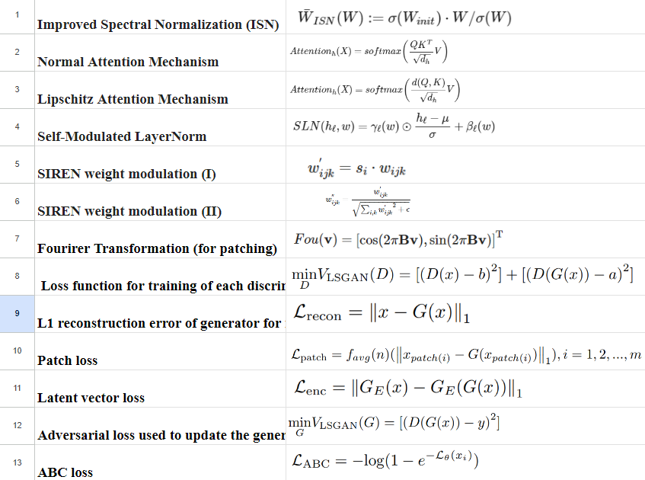
Back to Agenda
Implementation
Formula Used:
21

Slide 22
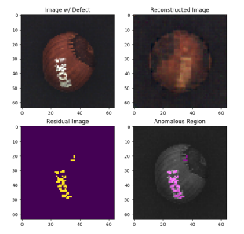
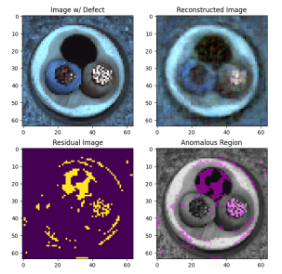
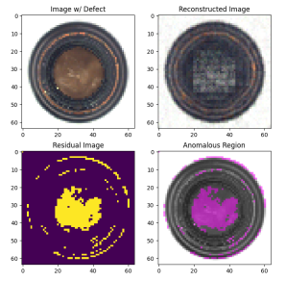
Back to Agenda
Results and Discussions
MVTecAD Dataset:
Here we have anomalous image from hazelnut , cable-wire and bottle dataset and we can see how the model reconstructs the test image and then we highlight the anomalies in the images.
22

Slide 23
Back to Agenda
Results and Discussions
MVTecAD Dataset:
We obtain accuracy for ‘good’ and ‘anomalous’ images of each class of MVTec-AD dataset and obtain an average accuracy of 0.89 for ‘good’ images and 0.59 for ‘anomalous’ images
23

Slide 24
Back to Agenda
Results and Discussions
CIFAR-10 Dataset:
Training the model spans 10 epochs and we use AUROC scores for each class to measure the performance. The model gives the best auroc score of 0.83 for class-8 as normal images and an average score of 0.79 over all classes.
Class | 0 | 1 | 2 | 3 | 4 | 5 | 6 | 7 | 8 | 9 | AVERAGE
Score | 0.81 | 0.82 | 0.74 | 0.72 | 0.76 | 0.75 | 0.82 | 0.8 | 0.83 | 0.81 | 0.79
24

Slide 25
Back to Agenda
Results and Discussions
Insights from the Results:
Our experimentation with anomaly detection on the MVTecAD dataset has yielded promising outcomes, particularly in accurately identifying normal images.
However, the efficacy diminishes when detecting anomalies, primarily due to the subtle nature of anomalies that may evade detection with a singular threshold approach.
In our exploration of anomaly detection on the CIFAR-10 dataset, employing two discriminators has significantly heightened computational demands. Consequently, we were compelled to curtail the number of training epochs to align with available hardware resources.
Although our achieved score of 0.79 showcases commendable performance, the potential for improvement remains considerable.
25

Slide 26
Our project demonstrates promising advancements in anomaly detection using innovative approaches such as TransGAN and multi-discriminator architectures. Despite achieving notable accuracy in identifying normal images, challenges persist in accurately detecting subtle anomalies, warranting further refinement. We can continue working on this project for better results by: Enhanced Anomaly Detection: Investigate advanced training strategies to improve discrimination between normal and anomalous images, enhancing overall detection accuracy. Optimized Computational Resources: Explore optimizations to mitigate computational demands, enabling deeper model training and improving detection capabilities
Conclusion and Future Work
26

Slide 27
Feature Extractor Exploration Evaluate alternative feature extractors beyond ResNet50 to enhance feature representation and bolster anomaly detection performance. Adaptive Thresholding: Develop adaptive thresholding techniques to dynamically adjust anomaly detection thresholds, accommodating varying degrees of anomaly severity. Real-world Application Testing: Extend testing to real-world scenarios to validate the efficacy of our anomaly detection methodologies in practical settings.
Conclusion and Future Work
27

Slide 28


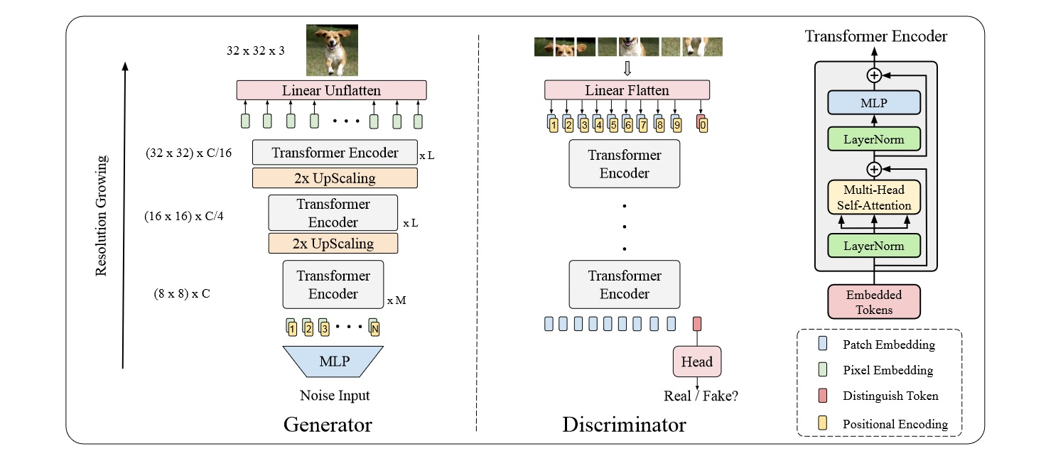
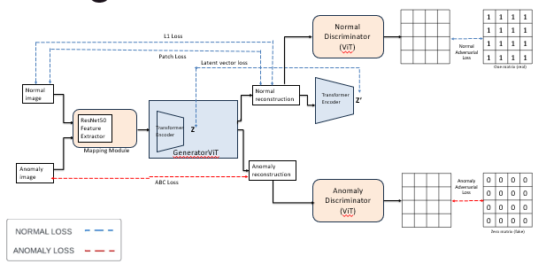
ANOMALY DETECTION USING TRANSFORMER BASED GANS
Nayan Khemka – 20BCE1884
Dr.Premalatha M.
School of Computer Science and Engineering
MOTIVATION / INTRODUCTION
Anomaly detection in images is a challenging problem due to the diverse anomalies and the complex patterns they exhibit. The project presents an intellectually stimulating challenge, enticing those driven by curiosity and the desire to solve complex puzzles.
he opportunity to explore cutting-edge technology like TransGAN in anomaly detection offers a chance to contribute to the frontier of research and innovation. Being among the first to apply such advanced methodologies can lead to groundbreaking discoveries and recognition within the scientific community.
The potential real-world applications of effective anomaly detection are vast and impactful. From ensuring product quality in manufacturing to detecting abnormalities in medical scans, the project offers the opportunity to make a tangible difference in various domains, ultimately improving safety, efficiency, and reliability.
OBJECTIVES
Evaluate TransGAN's efficacy in detecting anomalies within image datasets, comparing its performance against traditional methods.
Develop and implement novel anomaly detection methodologies using TransGAN-generated images, focusing on enhancing accuracy and robustness.
Optimize anomaly detection algorithms to achieve high accuracy and efficiency while ensuring scalability and resource efficiency.
Assess the potential real-world applications of TransGAN-based anomaly detection across industries, analyzing its effectiveness in practical scenarios.
SCOPE OF THE PROJECT
The scope of this project is to leverage TransGAN for anomaly detection in image datasets, focusing on developing innovative methodologies, optimizing performance, and evaluating real-world applicability. Through meticulous analysis and documentation, it seeks to contribute to advancing anomaly detection research.
METHODOLOGY
We use two different approaches for two datasets using the same model. For MVTec-AD dataset we use latent space mapping. While for CIFAR-10 we employ usage of two discriminators and different losses for anomaly classification.
ARCHITECTURE
We use this transGAN architecture for both the datasets as explained before. We train the dataset on this model to generate realistic images. Now for MVTec-AD we use this trained model on test images and use reconstruction and discriminator loss to classify anomalous and normal images.
In case of CIFAR-10 dataset we make use of the given system flow where we use two discriminator and a combination of multiple losses to classify an image as anomalous or normal.
RESULTS
CONCLUSION
In summary, this project achieved notable results in anomaly detection using TransGAN. With an accuracy of 89.7% for normal images and 60% for anomalous images in MVTec-AD, and an average AUROC score of 0.74 in CIFAR-10, it demonstrates the effectiveness of TransGAN-based methodologies. These findings signify promising prospects for TransGAN in anomaly detection applications.
CONTACT DETAILS
MAIL ID nayankhemka9@gmail.com
MOBILE NO 9874991088
REFERENCES
Jiang, Y., Chang, S., & Wang, Z. (2021). TransGAN: Two Transformers Can Make One Strong GAN. ArXiv, abs/2102.07074
Schlegl, T., Seeböck, P., Waldstein, S.M., Schmidt-Erfurth, U.M., & Langs, G. (2017). Unsupervised Anomaly Detection with Generative Adversarial Networks to Guide Marker Discovery. Information Processing in Medical Imaging.
Sabokrou, M., Khalooei, M., Fathy, M., & Adeli, E. (2018). Adversarially learned one-class classifier for novelty detection. In Proceedings of the IEEE conference on computer vision and pattern recognition (pp. 3379-3388)
Yang, C., Lan, S., Huang, W., Wang, W., Liu, G., Yang, H., ... & Li, P. (2022, September). A transformer-based gan for anomaly detection. In International Conference on Artificial Neural Networks (pp. 345-357). Cham: Springer Nature Switzerland
Algorithm | Result
Latent Space Mapping (Accuracy) | Good Images | Anomalous Images
 | 0.89 | 0.6
2Discrimator approach (AUROC) | 0.79
28

Slide 29

Guide Approval
29

Slide 30
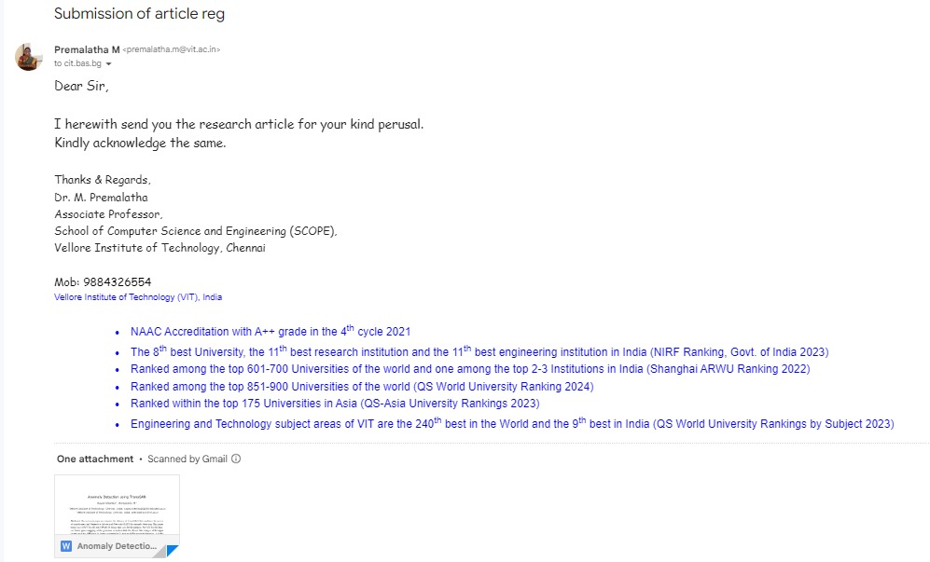
The paper has been sent to Cybernetics and Information Technologies (CIT) [ https://cit.iict.bas.bg/cit-call-papers.html ] and is currently under review.
RESEARCH PAPER STATUS
30

Slide 31
[1]. Ghazal, M., Vázquez, C., & Amer, A. (2007). Real-time automatic detection of vandalism behavior in video sequences. 2007 IEEE International Conference on Systems, Man and Cybernetics, 1056- 1060. [2]. Mould, N., Regens, J.L., Jensen, C., & Edger, D.N. (2014). Video surveillance and counterterrorism: the application of suspicious activity recognition in visual surveillance systems to counterterrorism. Journal of Policing, Intelligence and Counter Terrorism, 9, 151 - 175. [3]. Jiang, Y., Chang, S., & Wang, Z. (2021). TransGAN: Two Transformers Can Make One Strong GAN. ArXiv, abs/2102.07074. [4]. Goodfellow, I.J., Pouget-Abadie, J., Mirza, M., Xu, B., Warde-Farley, D., Ozair, S., Courville, A.C., & Bengio, Y. (2014). Generative Adversarial Nets. Neural Information Processing Systems. [5]. Schlegl, T., Seeböck, P., Waldstein, S.M., Schmidt-Erfurth, U.M., & Langs, G. (2017). Unsupervised Anomaly Detection with Generative Adversarial Networks to Guide Marker Discovery. Information Processing in Medical Imaging. [6]. Bergmann, P., Fauser, M., Sattlegger, D., & Steger, C. (2019). MVTec AD — A Comprehensive Real-World Dataset for Unsupervised Anomaly Detection. 2019 IEEE/CVF Conference on Computer Vision and Pattern Recognition (CVPR), 9584-9592. [7]. Krizhevsky, A. (2009). Learning Multiple Layers of Features from Tiny Images. [8]. He, K., Zhang, X., Ren, S., & Sun, J. (2015). Deep Residual Learning for Image Recognition. 2016 IEEE Conference on Computer Vision and Pattern Recognition (CVPR), 770-778. [9]. Kwon, D., Natarajan, K., Suh, S.C., Kim, H., & Kim, J. (2018). An Empirical Study on Network Anomaly Detection Using Convolutional Neural Networks. 2018 IEEE 38th International Conference on Distributed Computing Systems (ICDCS), 1595-1598. [10]. Sabokrou, M., Fayyaz, M., Fathy, M., Moayed, Z., & Klette, R. (2016). Deep-anomaly: Fully convolutional neural network for fast anomaly detection in crowded scenes. Comput. Vis. Image Underst., 172, 88-97. [11]. Pang, G., Shen, C., Cao, L., & Hengel, A.V. (2020). Deep Learning for Anomaly Detection. ACM Computing Surveys (CSUR), 54, 1 - 38. [12]. Selvaraju, R.R., Das, A., Vedantam, R., Cogswell, M., Parikh, D., & Batra, D. (2016). GradCAM: Visual Explanations from Deep Networks via Gradient-Based Localization. International Journal of Computer Vision, 128, 336 - 359. 57.
References

Slide 32
[13]. Chalapathy, R., & Chawla, S. (2019). Deep Learning for Anomaly Detection: A Survey. ArXiv, abs/1901.03407. [14]. Bulusu, S., Kailkhura, B., Li, B., Varshney, P.K., & Song, D.X. (2020). Anomalous Example Detection in Deep Learning: A Survey. IEEE Access, 8, 132330-132347. [15]. Sabokrou, M., Khalooei, M., Fathy, M., & Adeli, E. (2018). Adversarially learned one-class classifier for novelty detection. In Proceedings of the IEEE conference on computer vision and pattern recognition (pp. 3379-3388) [16]. Zhang, H., Goodfellow, I., Metaxas, D., & Odena, A. (2019, May). Self-attention generative adversarial networks. In International conference on machine learning (pp. 7354-7363). PMLR. [17]. Shangguan, W., Fan, W., & Chen, Z. (2022, March). Semi-supervised anomaly detection based on deep generative models with transformer. In Proceedings of the 2022 6th International Conference on Innovation in Artificial Intelligence (pp. 172-177). [18]. Ruff, L., Vandermeulen, R. A., Görnitz, N., Binder, A., Müller, E., Müller, K. R., & Kloft, M. (2019). Deep semi-supervised anomaly detection. arXiv preprint arXiv:1906.02694. [19]. Yang, C., Lan, S., Huang, W., Wang, W., Liu, G., Yang, H., ... & Li, P. (2022, September). A transformer-based gan for anomaly detection. In International Conference on Artificial Neural Networks (pp. 345-357). Cham: Springer Nature Switzerland. [20]. Zhang, L., Dai, Y., Fan, F., & He, C. (2022). Anomaly Detection of GAN Industrial Image Based on Attention Feature Fusion. Sensors, 23(1), 355. [21]. Feng, X., Song, D., Chen, Y., Chen, Z., Ni, J., & Chen, H. (2021, October). Convolutional transformer based dual discriminator generative adversarial networks for video anomaly detection. In Proceedings of the 29th ACM International Conference on Multimedia (pp. 5546-5554). [22]. Dosovitskiy, A., Beyer, L., Kolesnikov, A., Weissenborn, D., Zhai, X., Unterthiner, T., ... & Houlsby, N. (2020). An image is worth 16x16 words: Transformers for image recognition at scale. arXiv preprint arXiv:2010.11929. [23]. Kim, J., Jeong, K., Choi, H., & Seo, K. (2020). GAN-Based Anomaly Detection In Imbalance Problems. ECCV Workshops. [24]. Vaswani, A., Shazeer, N., Parmar, N., Uszkoreit, J., Jones, L., Gomez, A. N., Kaiser, Ł. & Polosukhin, I. (2017). Attention is all you need. Advances in Neural Information Processing Systems (p./pp. 5998--6008).
References

Slide 33
THANK YOU

